Slide 1
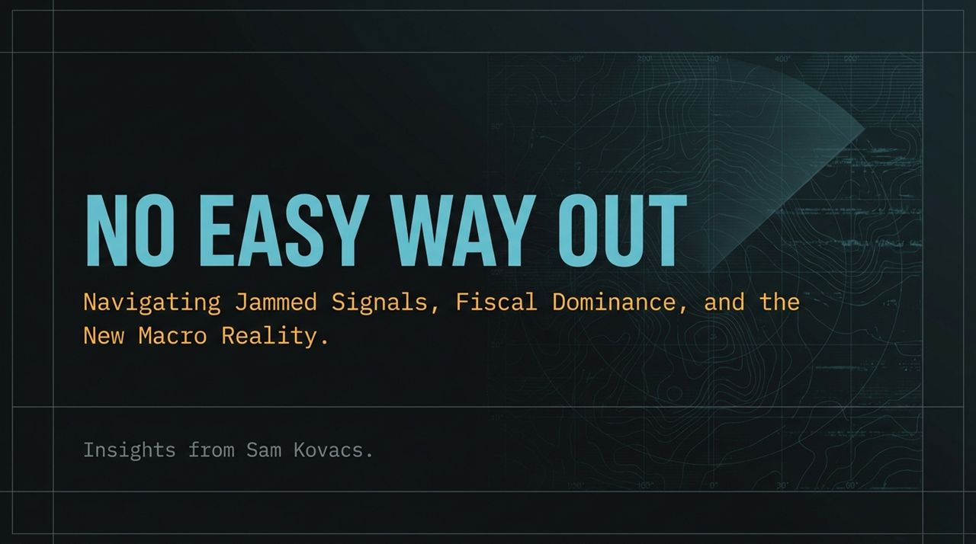
Notes:
Executive Opening & Theme Setting:
Good morning, everyone. Today’s presentation is titled 'No Easy Way Out: Navigating Jammed Signals, Fiscal Dominance, and the New Macro Reality' featuring key macro and strategic insights from investor Sam Kovacs. As the title suggests, we are operating in an unprecedented market environment where traditional frameworks are breaking down. If there’s one core takeaway to set the stage today, it’s that the era of easy money, cheap energy, and paper-market narrative trading is over.
The Core Metaphor — Jammed Signals & Physical Constraints:
Look closely at the cover graphic—it represents corrupted data streams, error codes (ERR 404 JAM SIGNAL LOST), and breaking connections. That isn't just an aesthetic; it is our primary macro thesis. Market price discovery is currently broken because information signals are being actively jammed by central bankers, corporate press releases, and algorithmic flows.
The Core Mandate:
While paper markets attempt to project business-as-usual, the physical economy—defined by real energy scarcity, supply chain friction, and fiscal realities—is screaming otherwise. To survive and outperform over the next decade, we must look past paper narratives and anchor our capital strictly to undeniable mathematical and physical truths. Let’s dive in.
No Easy Way Out | Sam Kovacs
https://www.youtube.com/watch?v=TBhFcNLIAyM

Slide 2
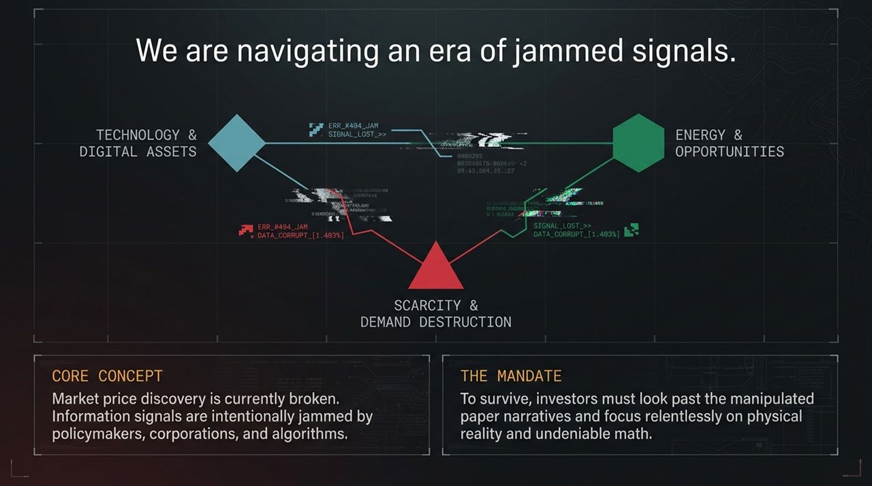
Notes:
Defining Jammed Signals in Modern Markets:
Slide 2 outlines the foundational framework of our current market environment. We are navigating three converging vectors: Technology & Digital Assets, Scarcity & Demand Destruction, and Energy & Real Asset Opportunities.
When we say 'signals are jammed,' what do we mean? Historically, asset prices served as an efficient mechanism to communicate economic health and allocate capital. Today, official data points are manipulated or delayed. For example, official figures tout stable crude oil flows or soft-landing scenarios, while underlying physical metrics—like diesel refined product inventory and real transport costs—tell a completely different story.
Breaking Down Price Discovery:
Algorithms, systematic flows, and central bank open-mouth operations have created a disconnect between paper derivative pricing and physical asset settlement. Investors are taking comfort in paper indices while physical supply chains endure structural friction.
Sam Kovacs calls this the 'denial phase'. When the price signal is corrupted, market participants develop false confidence. They buy high-multiple, long-duration assets under the assumption that discount rates will lower and energy will remain cheap indefinitely.
The Investment Mandate:
Notice 'The Mandate' at the bottom of the slide: To survive, investors must look past the manipulated paper narratives and focus relentlessly on physical reality and undeniable math. You cannot print physical energy, and you cannot print real supply chain throughput. In this presentation, we will dismantle these market illusions piece by piece.

Slide 3
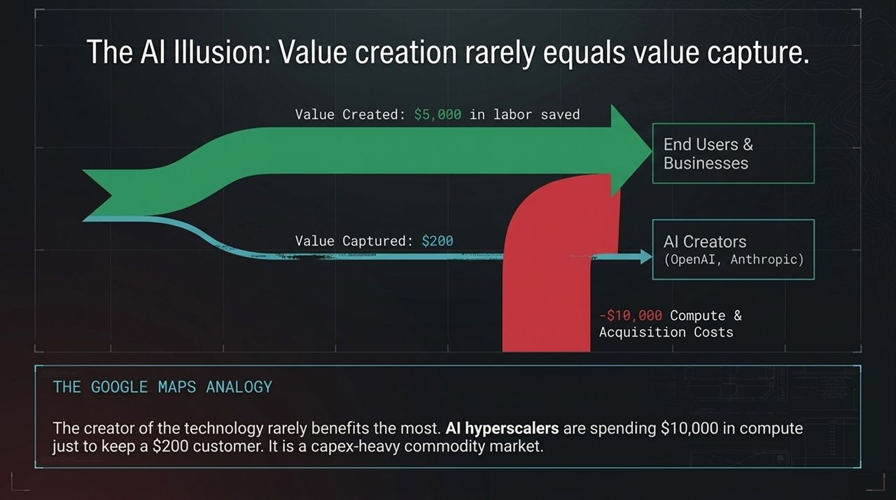
Notes:
The Technology Value Disconnect:
Let's start with one of the biggest consensus trades in the market today: Generative AI and Hyperscale tech infrastructure. The consensus narrative is simple: AI creates trillions in efficiency, so you should buy the AI creators at any valuation.
However, as Sam Kovacs highlights, value creation rarely equals value capture. Look at the flow chart on this slide: an end-user business adopts an AI tool and saves $5,000 in labor or time. How much of that $5,000 does the AI creator (like OpenAI or Anthropic) capture? Around $200 in basic subscription fees.
The Google Maps Analogy & The Hyperscaler Trap:
Think back to Google Maps. Google Maps completely revolutionized global travel and logistics, unlocking hundreds of billions in economic value for users and businesses. Yet, almost none of that value accrued to Google as direct profit. The consumer got the surplus.
The same dynamic is playing out in AI. AI hyperscalers are burning immense amounts of capital on GPU clusters, custom silicon, and power infrastructure—spending upwards of $10,000 in compute and acquisition costs just to retain a $200 subscription customer. They are operating in a capex-heavy commodity race to the bottom.
Matrix Breakdown — Consensus vs. Contrarian Strategy:
Let's compare the two sides of this trade:
Capex Requirements: Hyperscalers require billions for rapidly depreciating physical chips and fabs. Software beneficiaries have zero added hardware costs and leverage existing rails.
Pricing Power: Hyperscalers face commoditization and racing marginal costs. Enterprise software beneficiaries enjoy high margins, cutting internal labor costs by 50%+.
Market Action: Private hyperscalers have tapped out private equity and are resorting to circular debt/vendor financing.
Actionable Takeaway:
The strategy is clear: Step away from the commoditized hardware/infrastructure trade and own the high-margin software beneficiaries who actually keep the cost savings on their balance sheets.

Slide 4
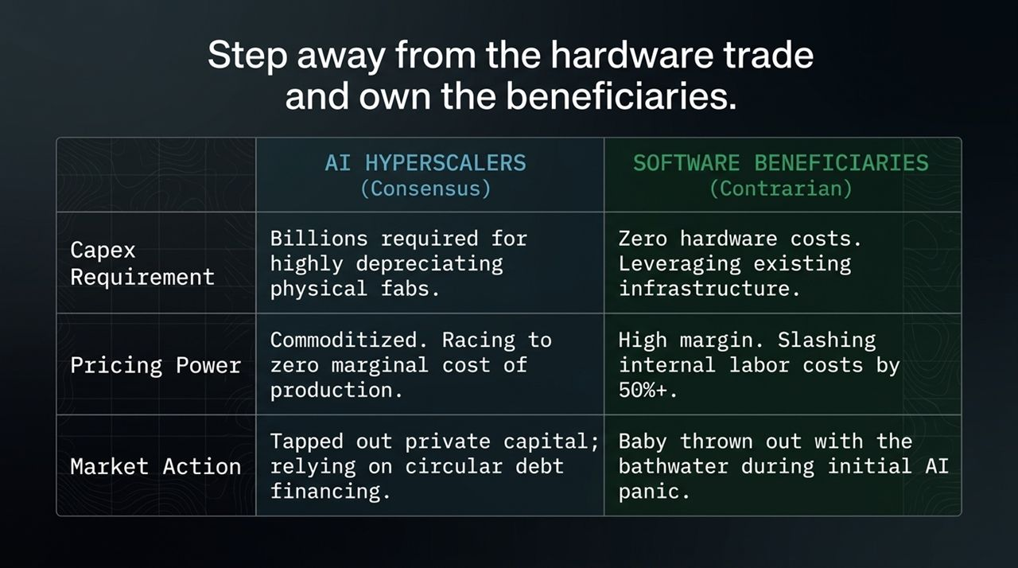
Notes:
The Monetary Policy Flaw:
Moving to monetary policy, Slide 4 visualizes the Federal Reserve’s structural dilemma. The graphic shows the American Consumer caught in a vise between Fed Rate Hikes from above and Physical Fuel Spikes from below.
The core policy mistake here is simple: The Federal Reserve is attempting to solve a supply-side physical energy crisis using demand-side monetary tools. Raising interest rates by 25 or 50 basis points does not drill a single new oil well, nor does it fix a damaged refinery or clear a maritime blockade.
The Inflationary & Margin Impulse:
When physical fuel prices spike—with Diesel up +50% and Gasoline up +70% YTD—it acts as an immediate tax on every individual and business. You cannot opt out of driving to work or shipping products. Rising fuel natively destroys discretionary spending before it ever touches official CPI numbers.
By hiking rates into an active energy shock, policymakers are hitting the economy twice. They elevate borrowing costs on consumer debt and mortgage resets right when household balance sheets are being drained at the gas pump.
Historical Precedent & The Middle Class Squeeze:
Sam Kovacs compares this setup to Arthur Burns in 1973, who kept monetary conditions tight during severe oil shocks, escalating stagflationary damage. Hiking into an energy deficit doesn't cure inflation cleanly; it guarantees an inflationary impulse that crushes middle-class purchasing power and squeezes corporate profit margins across non-essential sectors.

Slide 5
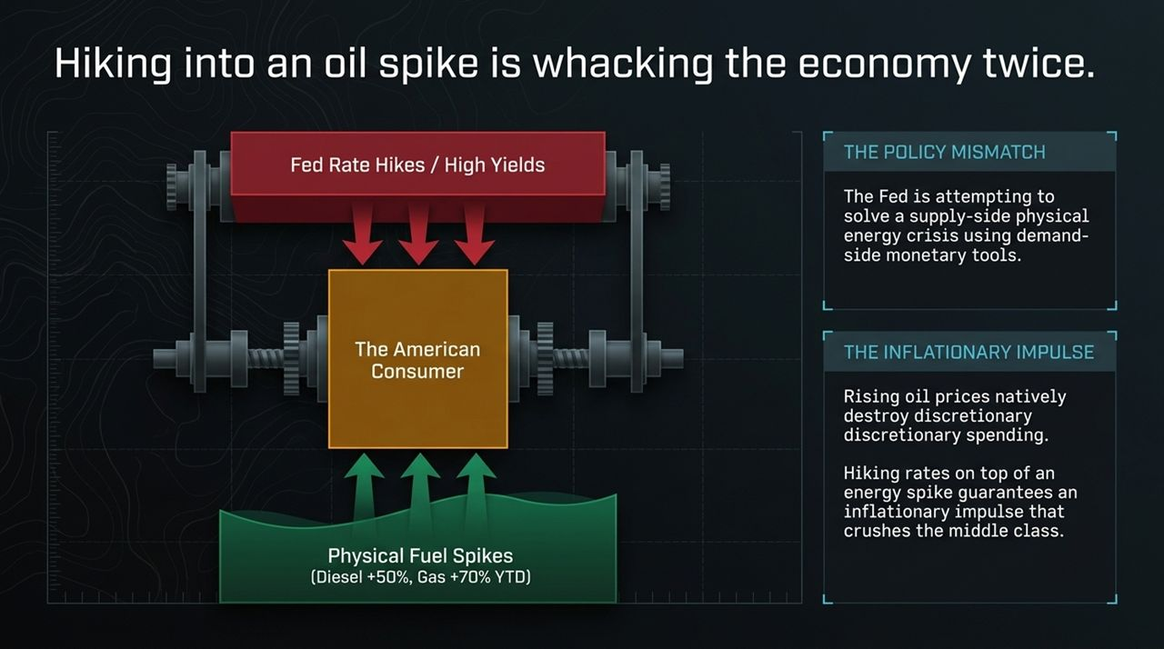
Notes:
Paper Markets vs. Physical Reality:
Slide 5 illustrates the stark contrast between what the paper market sees and what is actually happening on the ground globally.
In paper futures markets, headline prices often look range-bound around $60–$80 due to Strategic Petroleum Reserve (SPR) releases, government jawboning, and official reports. For instance, official CENTCOM updates claim 16 million barrels per day are moving smoothly through the Strait of Hormuz. But satellite tracking and tanker data ask the obvious question: 'WHERE ARE THE SHIPS?'
Unpacking Global Physical Cracks:
Look at the real-world data points around the perimeter:
Russia: Drone strikes have knocked out over 250,000 barrels per day in refining capacity.
France: 11% of domestic gas stations ran completely dry due to physical supply bottlenecks.
Pakistan: Re-instituted pandemic-style lockdowns strictly to curtail national fuel usage.
China: Shanghai crude traded at $125/bbl—a massive $20+ physical premium over Brent futures.
The 4-Phase Demand Destruction Sequence:
How does this macro contradiction resolve itself? Through a brutal 4-Phase Demand Destruction sequence:
Phase 1: Discretionary Cuts: Consumers stop buying new apparel, shoes, and non-essentials.
Phase 2: Service Contraction: Dining out drops off. (Real-world proof: Wendy’s largest franchisee filed for bankruptcy across 300+ restaurant units).
Phase 3: Capital Erosion: Adjustable-rate mortgages reset under higher yields, quietly wiping out household equity and capital gains.
Phase 4: Hard Demand Destruction: Workers stop driving; structural energy deficits force recessionary job losses.
Paper markets can ignore physical deficits for months, but eventually, physical settlement forces paper prices to catch up.

Slide 6
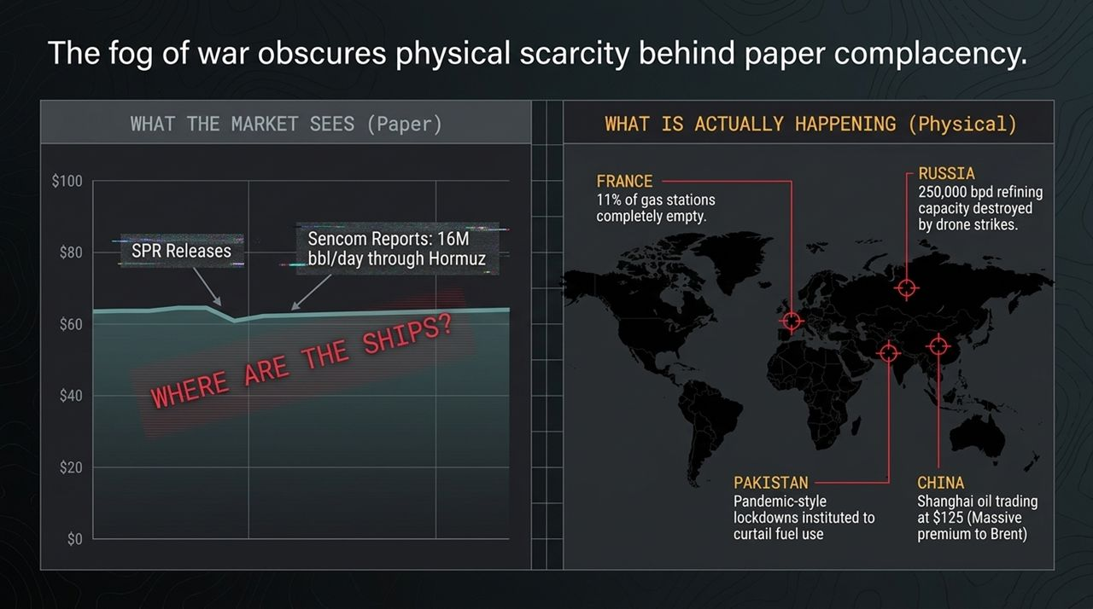
Notes:
The Structural Deficit Scale:
If energy scarcity is the physical constraint on our economy, fiscal dominance is the mathematical trap. Slide 6 highlights the stark reality of US sovereign finances.
The federal government brings in roughly $5 Trillion in income (tax revenue) while spending $7 Trillion annually. As Sam Kovacs notes: 'There is no person, business, or government who can outspend their earnings by 30% to 40% annually and expect to stay solvent.'
Structural Headwinds to Growth:
In standard economic modeling, you can outgrow debt through three drivers: demographic expansion, productivity gains, or cheap leverage.
Demographics: Stalled as the Boomer generation retires.
Productivity: Broad systemic productivity gains are currently absent.
Debt: Debt was the sole marginal growth driver, but with yields rising, that debt engine is at its breaking point.
Evaluating the Three Release Valves:
With a $40 Trillion national debt burden, there are theoretically three release valves:
Austerity (BLOCKED): Tax hikes or spending cuts are politically impossible. The retiring Boomer voting bloc demands entitlement outlays, and Congress remains locked in structural deficits.
Default (BLOCKED): Directly defaulting on US Treasuries would trigger an immediate collapse of global banking plumbing.
Currency Debasement (OPEN): The only remaining mathematical path.
Late-Stage Empire Playbook:
History confirms this pattern. From the Romans clipping silver coins to the British and Soviet post-war adjustments, late-stage empires facing unpayable debts and stalled growth always choose currency debasement. They inflate the money supply to service legacy debt with devalued currency.

Slide 7
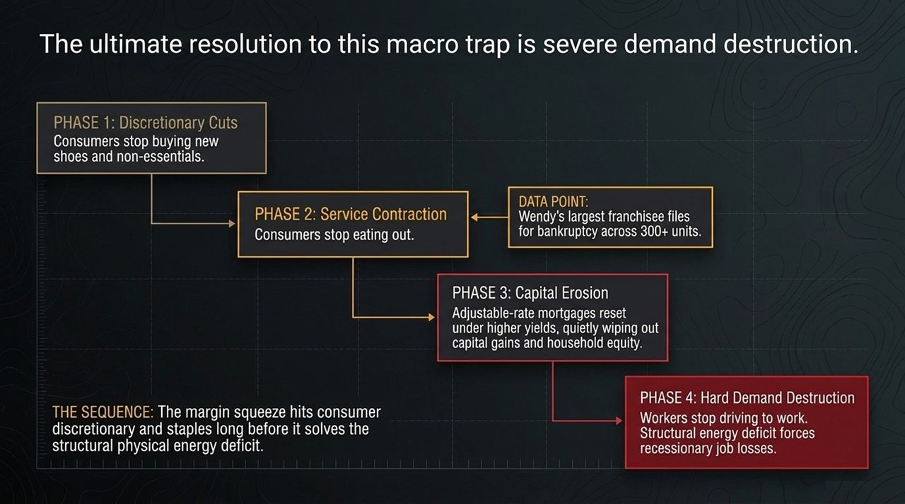
Notes:
The Foreign Reserve Flight:
Slide 7 presents a chart tracking foreign reserve flows. Specifically, look at Chinese FX reserves held in US Treasury assets. In 2003, US Treasuries made up 43% of China's foreign reserves. Today, that number has collapsed to just 18%.
The Catalyst & Exodus:
Why did this capital flee?
The Catalyst: When Western authorities froze Russian sovereign assets, it demonstrated to foreign capital that holding dollar-denominated reserves comes with political strings attached.
The Exodus: Foreign central banks realized the dollar was weaponized. They began aggressively rotating reserves out of paper Treasuries and into unencumbered physical assets like gold.
Domestic Impact: Borrowing a phrase from financial history: 'Never depend on the kindness of strangers.' Without foreign central banks absorbing new Treasury issuance, domestic yields must reset higher to attract buyers.
Capital Allocation — Structuring The Big Long:
To protect capital in this environment, Kovacs outlines 'The Big Long' asset allocation strategy:
50% OVERWEIGHT — Energy, Chemicals & Supply Chain: Direct exposure to physical scarcity and real assets.
25% OVERWEIGHT — Select Software: High-margin platforms that enable enterprise cost-cutting.
25% OVERWEIGHT — Healthcare & Senior Housing: Demographic-driven demand that is completely insulated from broader economic cycles.
0% UNDERWEIGHT — Consumer Discretionary & High-Multiple Staples: Zero exposure. Avoiding rich valuations facing severe margin compression.

Slide 8
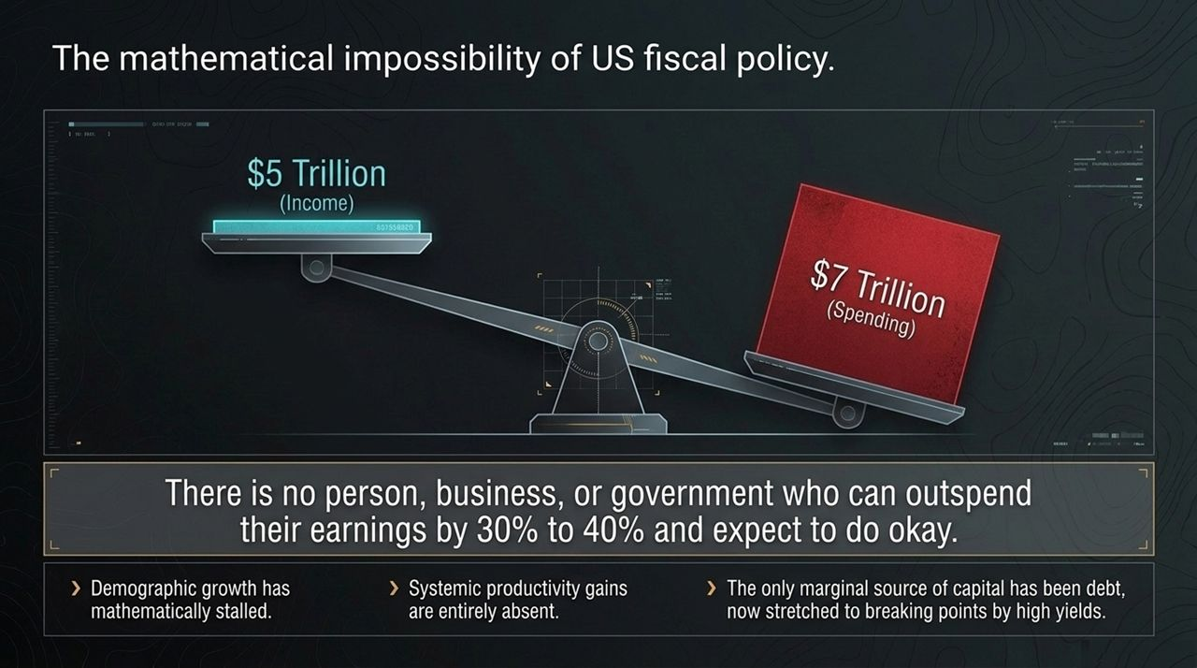
Notes:
Process Over Hope:
Slide 8 details portfolio management discipline and risk execution. A real investment thesis isn't just a narrative—it must be explicitly falsifiable.
Look at the decision-tree flowchart on the left:
Are US sanctions and blockades lifted? NO.
Is a new geopolitical MoU officially signed? NO.
Is the Strait of Hormuz securely open for business? NO.
OUTPUT: HOLD THE LINE. The core energy scarcity thesis remains structurally intact regardless of day-to-day paper price volatility.
Momentum Chasers vs. Process Investors:
Kovacs contrasts two distinct investor mindsets:
The Momentum Chaser ('Furu'): Worships daily price charts, gets emotionally attached to cost basis, panics when moving averages break, and expects linear 8% returns every year.
The Process Investor: Treats price fluctuations as opportunities, ignores historical cost basis, embraces market volatility, and focuses entirely on underlying business reality.
Core Portfolio Management Rules:
Two foundational guidelines govern this approach:
The Peter Lynch Rule: If a fundamental holding drops 15% on pure market noise, ask: 'Is the fundamental core story still intact?' If yes, you don't panic—you take advantage of Mr. Market's temporary illiquidity to buy more at a discount.
The Stanley Druckenmiller Rule: If the underlying facts change, drop your ego immediately. Mr. Market doesn't know or care what price you paid. Never waste time waiting to 'get back to even' on a broken thesis; cut the loss right away and deploy capital into a faster horse.

Slide 9
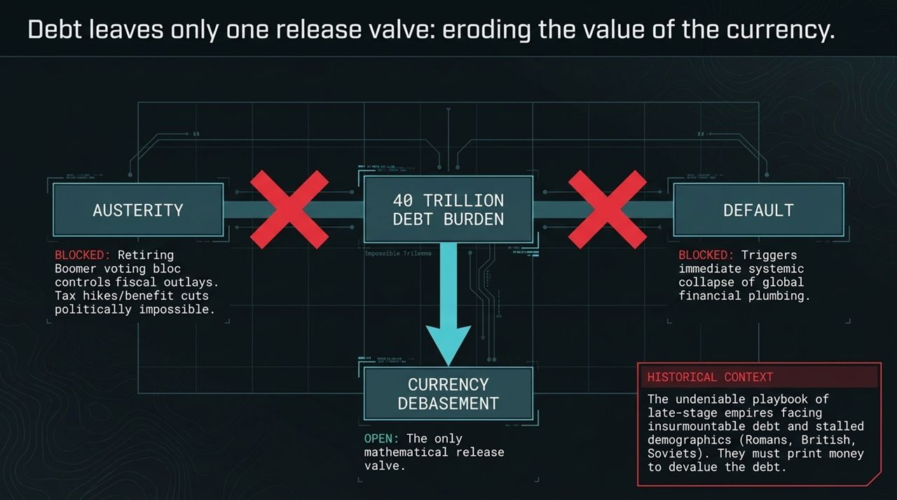
Notes:
Visualizing Hardware Vulnerability:
Slide 9 features a stark icon: a cracked microchip. This represents the physical vulnerability of the global hardware and semiconductor supply chain.
Fabs, Capex, and Supply Glut:
While software platforms enjoy low incremental marginal costs, semiconductor manufacturing requires massive, front-loaded capital expenditure. Advanced semiconductor fabs take years to build and billions to equip.
When hardware demand experiences minor cyclical downturns or geopolitical friction, these high-fixed-cost foundries face swift margin compression. Hardware silicon is ultimately a capital-intensive commodity cycle.
Portfolio Positioning:
This visual reinforces why our framework avoids overpaying for hardware infrastructure multiples at the top of a capex cycle, focusing capital instead on asset-light beneficiaries.

Slide 10
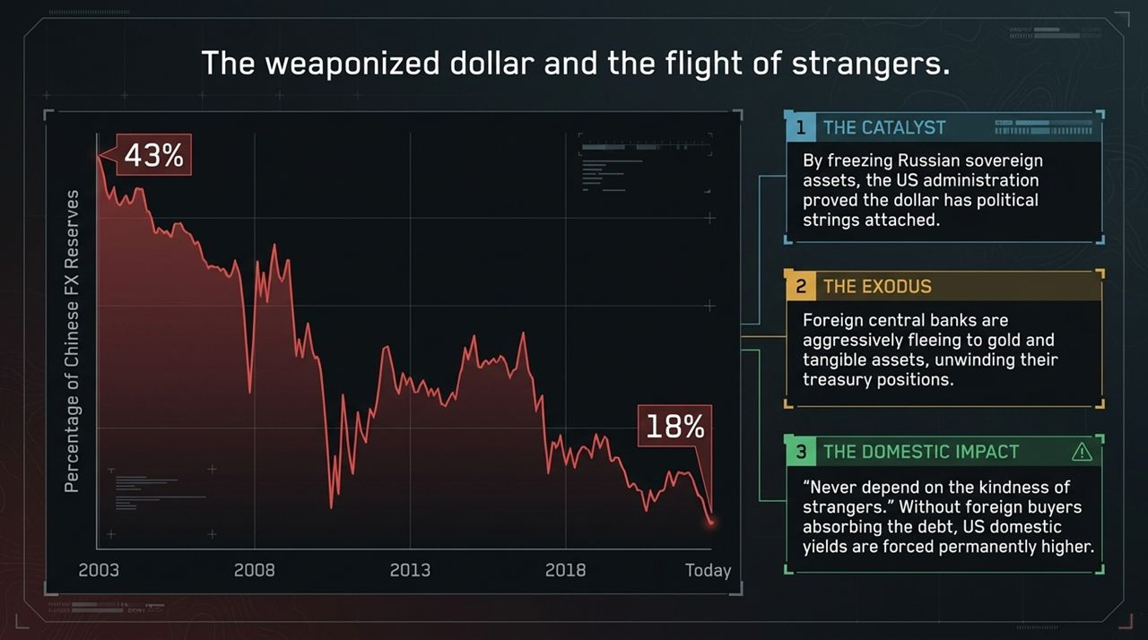
Notes:
The Empty Barrel & Physical Deficits:
Slide 10 presents the second core structural pillar: an empty oil barrel showing physical cracks.
Refined Products & Diesel Breakdown:
This graphic underscores that energy scarcity isn't a future risk—it is happening now in refined product inventories. As crude flows encounter friction, the lack of spare refining capacity creates severe supply bottlenecks for middle distillates like diesel and jet fuel.
Diesel powers heavy industrial transportation, agricultural equipment, and global freight. When diesel barrels run low, transportation costs surge across the entire economy.
The Structural Floor:
Paper contracts can be shorted synthetically, but physical barrels cannot be printed. Physical inventory deficits create an undeniable valuation floor for energy producers and supply chain operators.

Slide 11
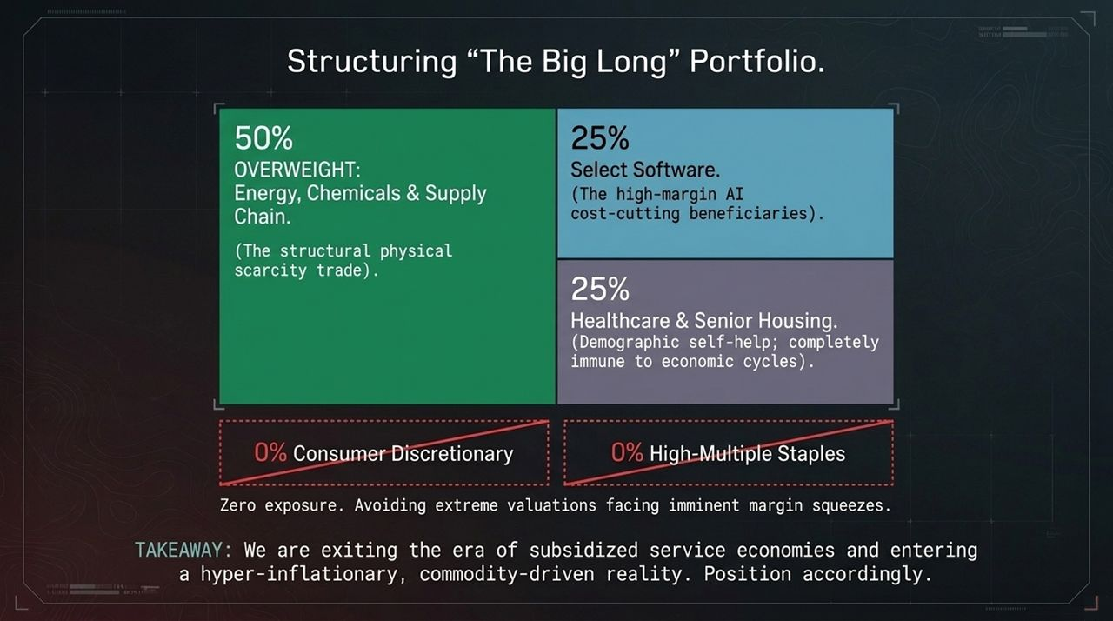
Notes:
The Melting Dollar:
Slide 11 features our third structural pillar: a melting gold dollar coin, representing the continuous loss of fiat currency purchasing power.
Debt Monetization Mechanism:
When sovereign governments run multitrillion-dollar structural deficits while central banks anchor yields to service national debt, the currency acts as the economic pressure release valve.
Fiat money loses its role as a stable store of value over time. Holding idle cash or unhedged low-yielding paper bonds guarantees real capital erosion.
Real Asset Imperative:
To preserve wealth through this decade, capital must be anchored to hard assets, energy cash flows, and scarce productive businesses that adjust prices alongside inflation.

Slide 12
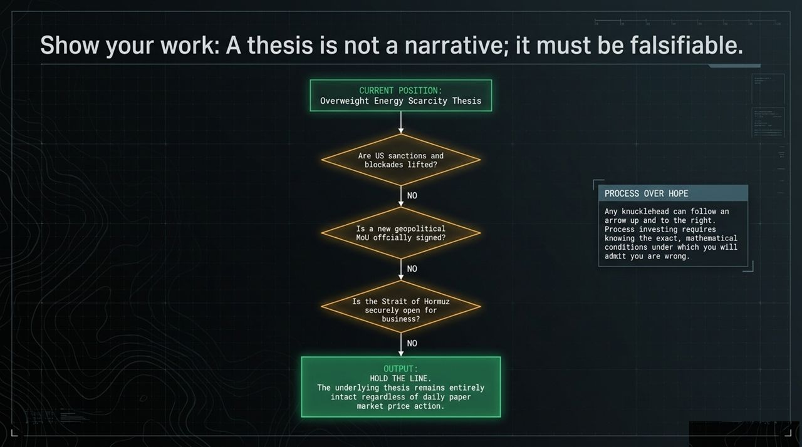
Notes:
Synthesizing the Three Pillars:
Slide 12 synthesizes our core diagnostic framework into three concrete realities:
THE TECH ILLUSION: The era of cheap, subsidized market returns driven by artificial liquidity and hyper-valuations is officially over.
THE PHYSICAL SQUEEZE: We are entering a volatile, commodity-driven regime defined by severe structural energy scarcity and supply constraints.
FISCAL DEBASEMENT: Sovereign debt burdens guarantee the ongoing loss of currency purchasing power. Paper bonds are no longer a risk-free safe haven.
The Final Mandate:
Read the final mandate at the bottom: Success in this decade requires ignoring jammed market signals, focusing purely on undeniable physical reality, and relying on ruthless, ego-free process over hope.
Executive Synthesis:
Investors who adapt to this paradigm shift early will protect and grow their capital; those who rely on outdated paper models risk severe drawdowns.

Slide 13
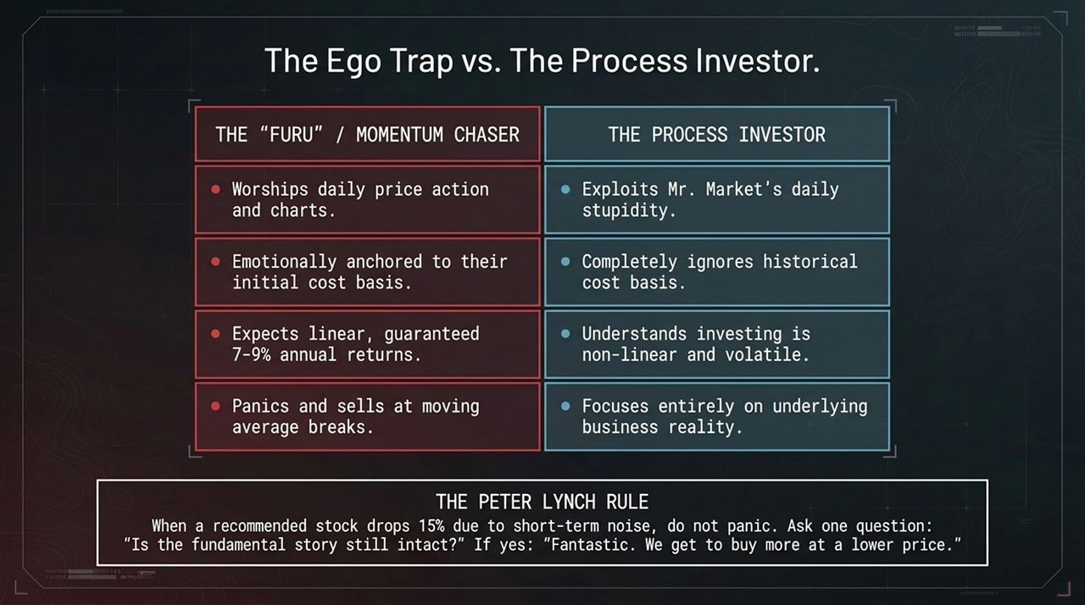
Notes:
Macro Dashboard Overview:
Slide 13 brings together the visual infographic dashboard summarizing the macro mechanics driving this regime shift.
Key Sub-Panels:
The 'Slowly, Then Suddenly' Paradigm: Markets adjust gradually until physical limits force rapid re-pricings.
The AI Value Disconnect: Highlighting the gap between $10,000 compute usage costs and $200 customer subscription revenues.
Jammed Signals in Energy: Showing how paper crude prices are held down synthetically, while physical diesel prices reflect true transport inflation and margin pressure.
Fiscal & Portfolio Alignment:
The dashboard highlights the $5T Income vs. $7T Spending fiscal imbalance, confirming currency debasement as the primary policy outcome.
On the portfolio side, it illustrates 'The Big Long' shift: moving away from vulnerable consumer retail/staples and overweighting supply-chain-linked energy and demographic-driven healthcare.

Slide 14
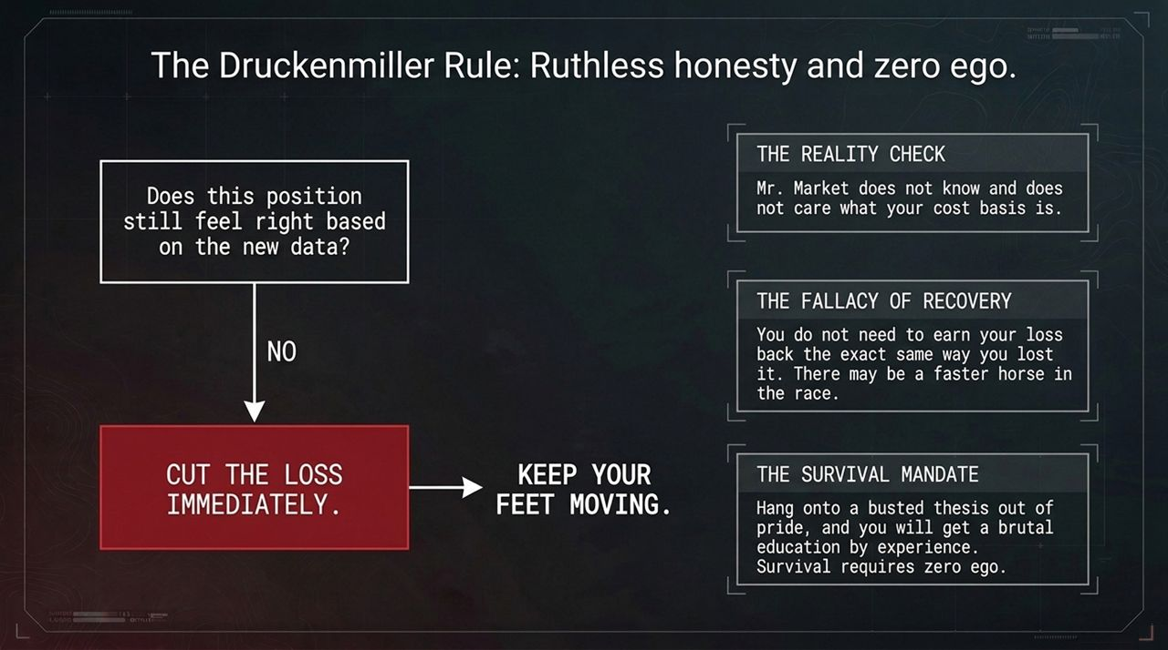
Notes:
Cross-Sector Comparative Analysis:
Slide 14 maps out value creation versus value capture across three distinct sectors:
The Three Models:
Google Maps (Tech Benchmark):
Primary Beneficiary: The Consumer and End-User.
Value Capturer: Low profit margin; value accrues primarily as brand reputation rather than direct cash flow.
Generative AI (Current Hype):
Primary Beneficiary: Power users and business efficiency adopters.
Value Capturer: Extremely expensive infrastructure providers facing massive capex and low net margins.
Energy & Physical Commodities (The Real Trade):
Primary Beneficiary: Suppliers, producers, and infrastructure operators.
Value Capturer: High-margin cash flow generators with strong pricing power driven by physical scarcity.
Strategic Conclusion:
To maximize return on capital, allocate toward sectors that directly capture high-margin cash flows rather than those subsidizing utility for end-users.

Slide 15
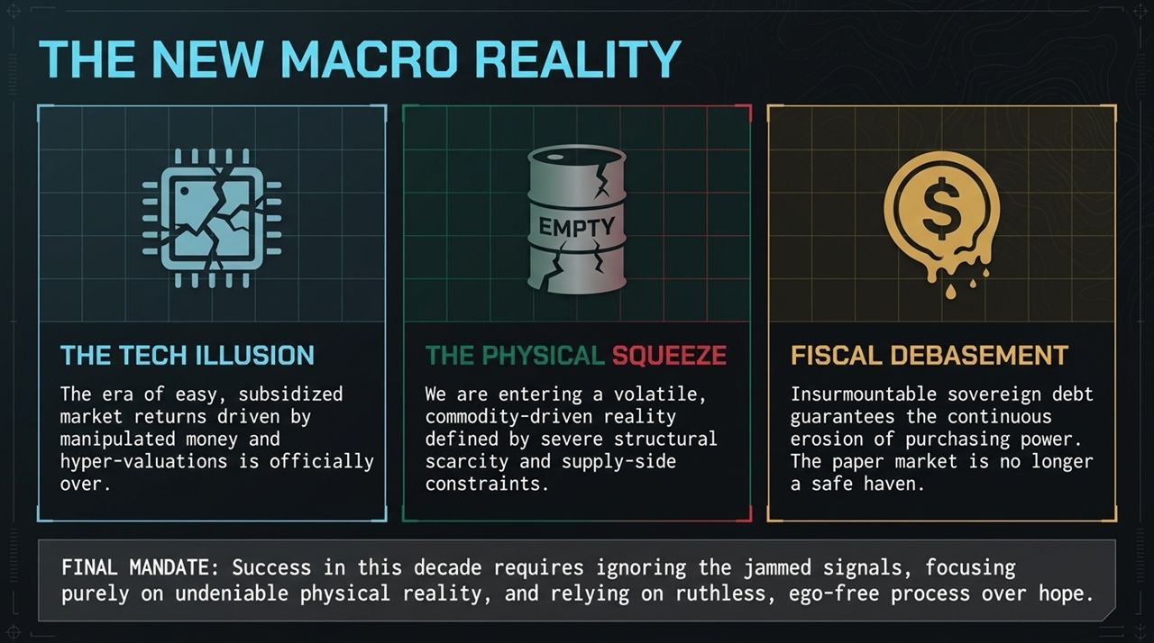
Notes:
The Consumer Squeeze:
Slide 15 illustrates our sector rotation framework.
As energy costs rise and interest rate resets drain household savings, consumer purchasing power deteriorates. Fast-food franchises, generic retail stores, and highly-valued consumer staples face shrinking margins and declining foot traffic.
Exiting Discretionary & High-Multiple Staples:
We mark Consumer Retail Stores and over-leveraged franchises as CLOSED opportunities. Passing higher input costs onto squeezed end-consumers becomes increasingly difficult.
Embracing Self-Help Assets:
Instead, pivot into resilient 'Self-Help' sectors:
Healthcare & Senior Housing: Driven by irreversible demographic tailwinds (aging Boomers), making them resistant to broader economic downturns.
Energy Infrastructure: Supply-chain-linked real assets that generate consistent, inflation-protected cash distributions.

Slide 16
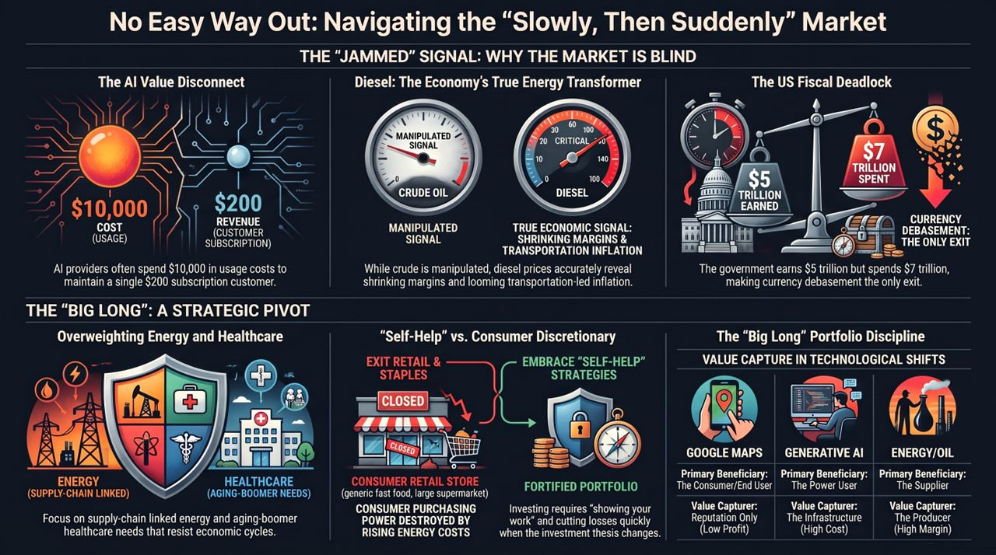
Notes:
Summary Framework:
Slide 16 concludes our presentation with the core principles of portfolio management:
Successful investing requires showing your work, maintaining clear analytic rigor, and executing without personal bias.
Summary Mandates:
Show Your Work: Every allocation must be backed by a clear, falsifiable thesis rather than speculative narratives.
Zero Ego Execution: If new data invalidates a core premise, cut the loss immediately. Never wait to 'get back to even' on a broken position.
Focus on Physical Reality: Ignore temporary paper market noise and keep capital aligned with real cash flows, energy scarcity, and structural fiscal realities.
Final Closing Statement:
By adhering to this process-driven discipline, we position our portfolio to protect capital, withstand volatility, and capture long-term real gains in the new macro reality. Thank you, and I am now open to taking questions.
No Easy Way Out | Sam Kovacs
https://www.youtube.com/watch?v=TBhFcNLIAyM

